Slide 1
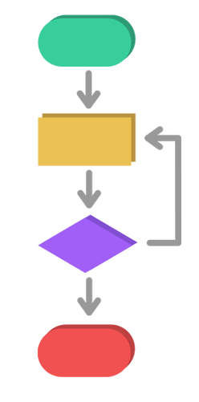
SHORTEST PATH ALGORITHMS
Hare Krishna Agrawal
Abhisht Bose
Dikshant Pratap Singh

Slide 2
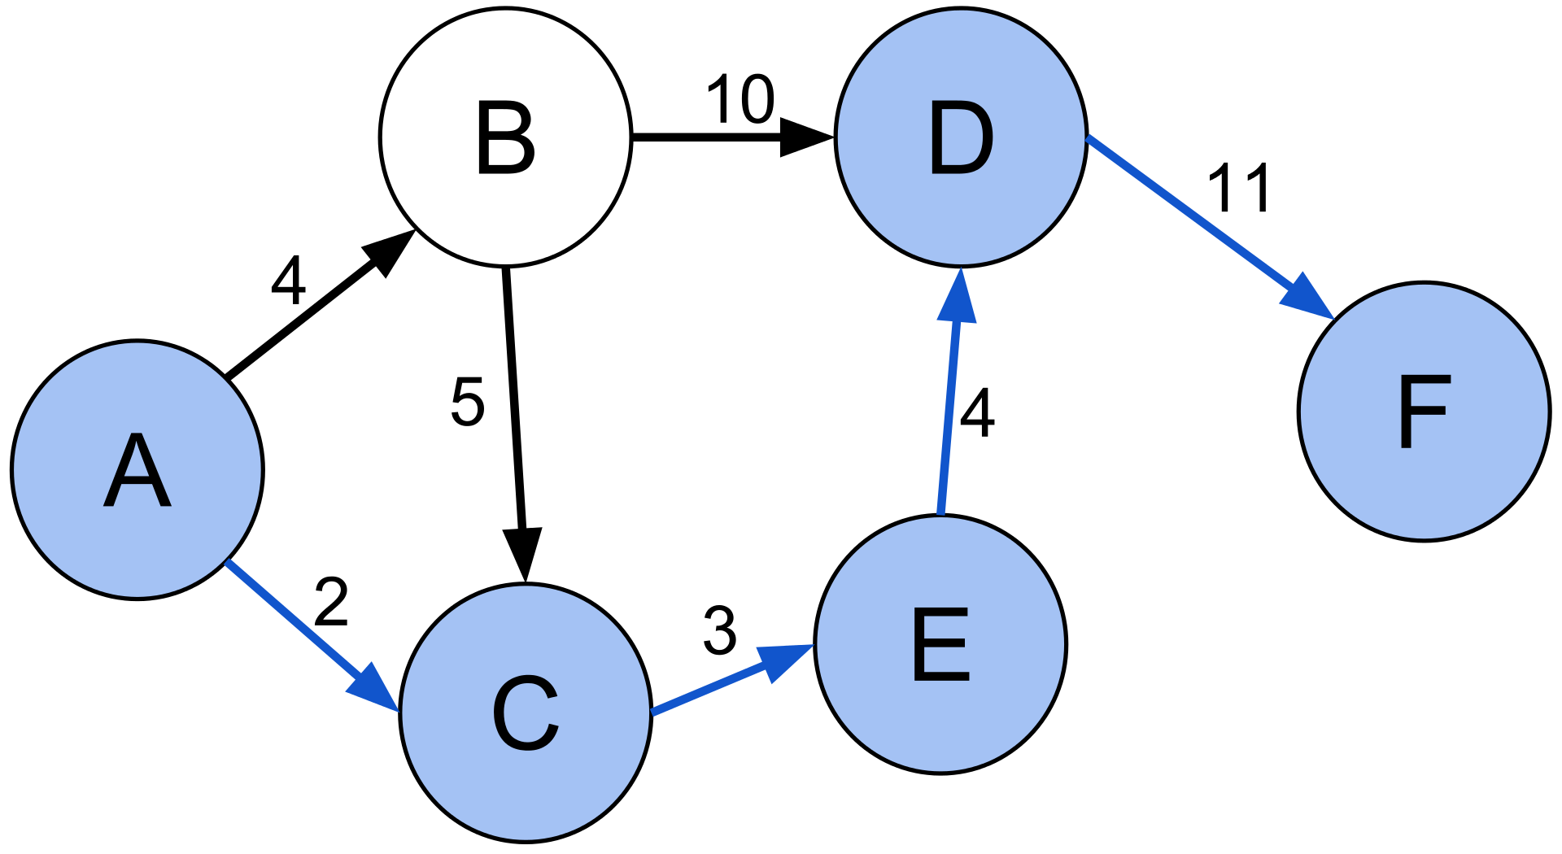
What is Shortest Path Problem?
In graph theory, the shortest path problem is the problem of finding a path between two vertices (or nodes) in a graph such that the sum of the weights of its constituent edges is minimized.
The problem of finding the shortest path between two intersections on a road map may be modeled as a special case of the shortest path problem in graphs, where the vertices correspond to intersections and the edges correspond to road segments, each weighted by the length of the segment.

Slide 3
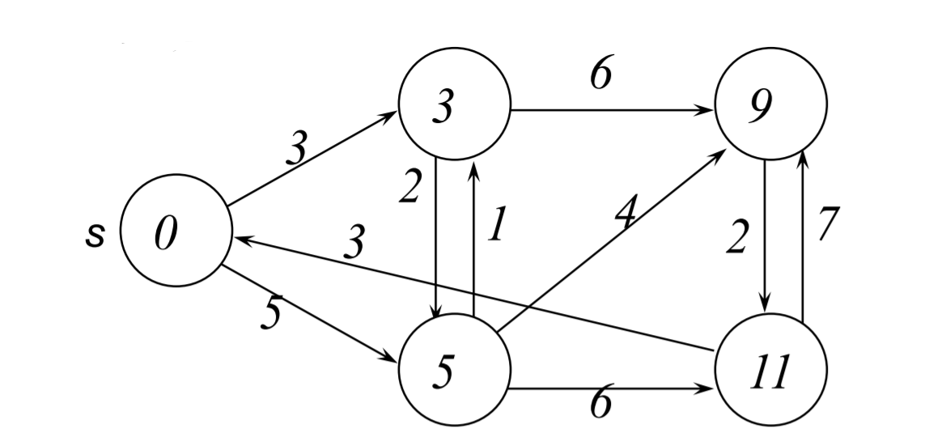
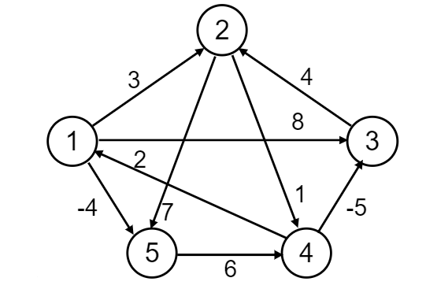
Types of Shortest Path Problem
Single-source shortest-paths problem: Find the shortest path from s to each vertex v. (e.g. BFS)
Single-destination shortest-paths problem: Find a shortest path to a given destination vertex t from each vertex v.
Single-pair shortest-path problem: Find a shortest path from u to v for given vertices u and v.
All-pairs shortest-paths problem: Find a shortest path from u to v for every pair of vertices u and v.
Single-source shortest-path
All-pairs shortest-path

Slide 4
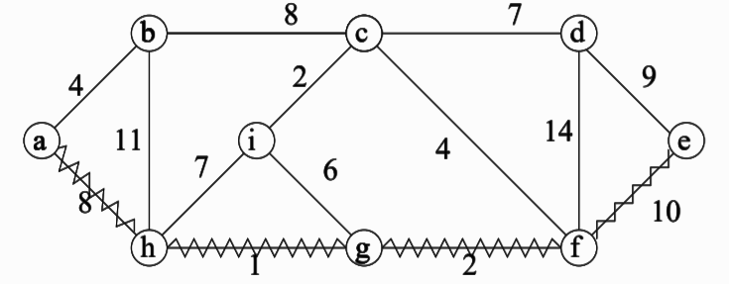
Formal Definition
G = (V, E) weighted graph, directed or undirected.
Weight of path P =< v₀, v₁, v₂, · · · , v_{k} > is
w(P) = sum(i=1 to k) w(v_{i−1}, v_{i})
Shortest path δ(u, v) from u to v has weight
δ(u, v) = min{w(P) : P is path from u to v}, If path exists
∞, Otherwise
Example: Shortest path from a to e (of length 21)
Properties of shortest paths: –
Subpaths of shortest paths are shortest paths
No (unique) shortest path exists if graph has cycle with negative weight

Slide 5
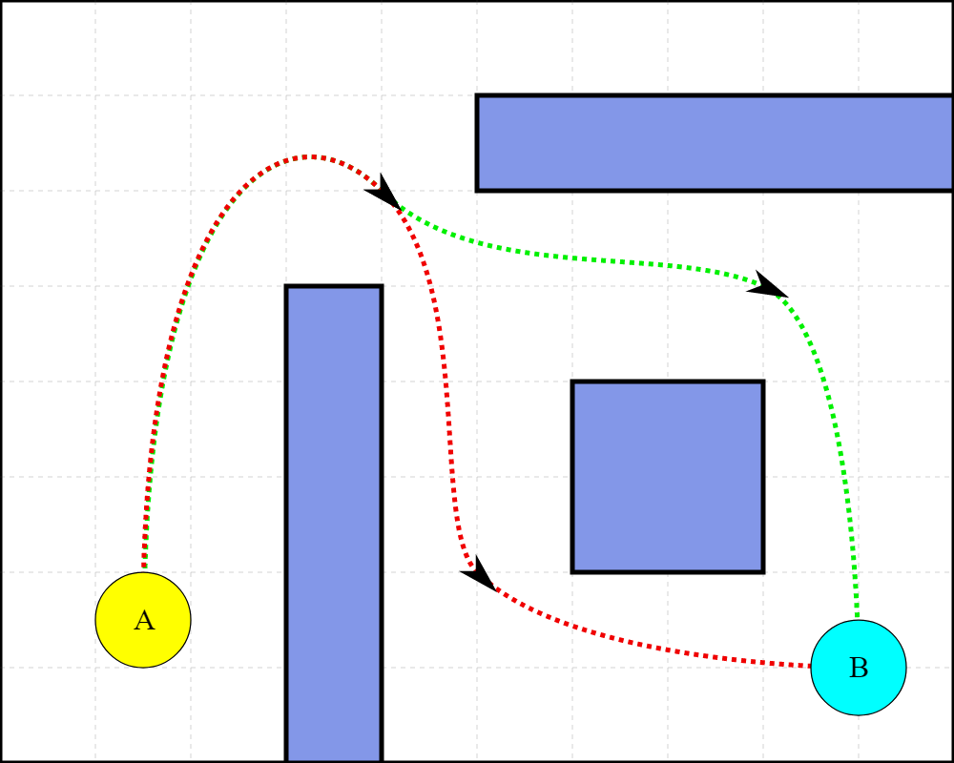
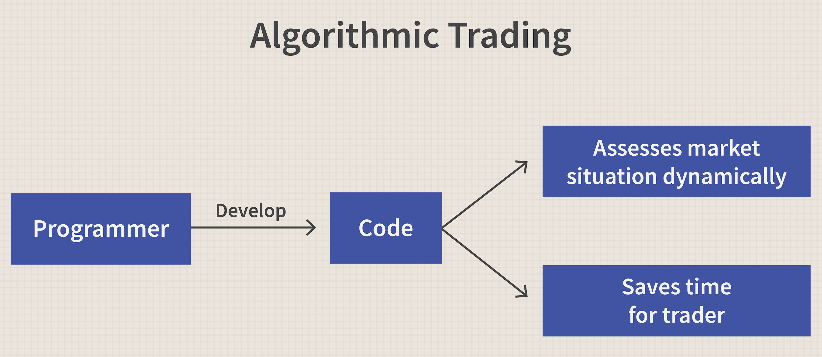
Motivation
The shortest path algorithm can be applied in a myriad of everyday things,
Given a number of cities with highways connecting them, find the shortest path from New Delhi to Lucknow.
The traffic and length of the highways are path weights.
Given a network of computers (eg, a peer-to-peer application), find the shortest path from machine A to machine B.
There is an interesting, application of the shortest path algorithms that is probably used quite often in algorithmic trading and financial sector that deals with trading assets and goods.
This situation is called arbitrage opportunity. This can be done with any asset and between different markets.
And many more…...

Slide 6
Objective
Our goal here is to implement 3 shortest path finding algorithms and look at their pros and cons.
The algorithms covered are:
Floyd–Warshall Algorithm
It is an algorithm for finding shortest paths in a directed weighted graph with positive or negative edge weights (but with no negative cycles). A single execution of the algorithm will find the lengths (summed weights) of shortest paths between all pairs of vertices.
Bellman–Ford Algorithm
The Bellman–Ford algorithm is an algorithm that computes shortest paths from a single source vertex to all of the other vertices in a weighted digraph. It is slower than Dijkstra's algorithm for the same problem, but more versatile
Dijkstra’s Algorithm
Dijkstra's algorithm is an algorithm for finding the shortest paths between nodes in a graph, which may represent, for example, road networks. It was conceived by computer scientist Edsger W. Dijkstra in 1956 and published three years later.

Slide 7
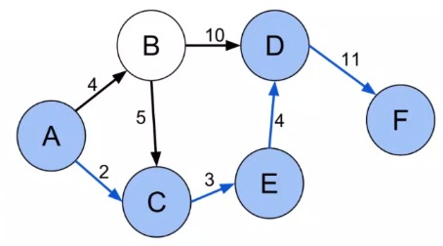
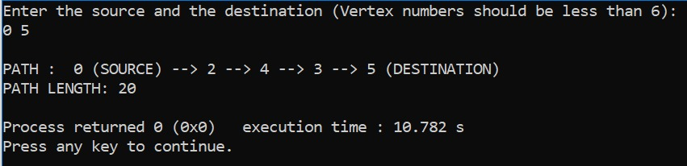

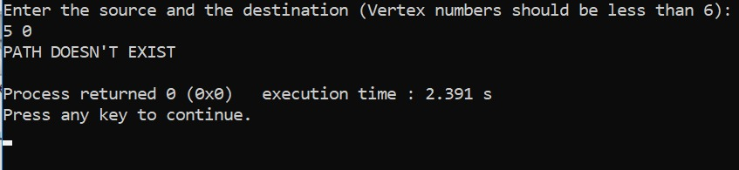
Input And Output
Given this Directed Graph
If a path exists:
If a path does not exists:
We enter the information like this where A=0, B=1….. with the weights as the 3rd input in each

Slide 8
Floyd-Warshall Algorithm
Pseudocode:
FLOYD_WARSHALL( #Vertices, Edge_Weights )
{
Let dist be a V * V matrix of minimum distances initialized to infinity
for each vertex v
dist[v][v] = 0
for each edge (u,v)
dist[u][v] = weight(u,v)
//In this loop we check if there exists any shorter path from ‘i’ to ‘j’ via ‘k’
If exists then update the value of dist[i][j]
for k from 0 to |V| - 1
for i from 0 to |V| - 1
for j from 0 to |V| - 1
if (dist[i][k] + dist[k][j] ) is less than dist[i][j] then
dist[i][j] = dist[i][k] + dist[k][j]
}

Slide 9
Analysis of Floyd-Warshall Algorithm
Main Points:
takes input of graph in the form of adjacency matrix
computes the shortest distances between every pair of vertices
It is more effective at managing multiple stops on the route because it can calculate the shortest paths between all relevant nodes.
Time Complexity:
consists of three loops over all the nodes
inner most loop consists of only constant complexity operations.
the asymptotic time complexity of Floyd Warshall algorithm is O(n³).
Space Complexity:
Adjacency matrix is O(n²). And all other spaces used are O(1).
the space complexity of the Floyd Warshall algorithm is O(n²).
Advantages/Disadvantages
Unwanted computations may take place
For average cases, provided graphs are sparse
Algorithm turns out to be slower than other shortest path finding algorithms.

Slide 10
Bellman-Ford Algorithm
Pseudocode:
function bellmanFord(G, Source_node) {
for each vertex V in G {
distance[V] <- infinite // saves the shortest distance from source to the array index
previous[V] <- (-1)
distance[Source_node] <- 0
}
for each vertex V in G {
for each edge (U,V) in G {
tempDistance <- distance[U] + edge_weight(U, V)
If ( tempDistance < distance[V] ) {
distance[V] <- tempDistance
previous[V] <- U
}
}
}
for each edge (U,V) in G
If distance[U] + edge_weight(U, V) < distance[V]
Error: Negative Cycle Exists
return distance[], previous[]
}

Slide 11
Analysis of Bellman-Ford Algorithm
Main Points:
It requires the input of the total number of vertices and all the edges (either positive or negative) .
Can be used on both weighted and unweighted graphs.
It is a single source, shortest path finding algorithm.
Relaxation works by continuously shortening the calculated distance between vertices comparing that distance with other known distances.
Time Complexity:
Runs two iterations
In every iterations it makes E relaxations and total number of iterations is V-1
So Time Complexity of this algorithm will be O(V*E).
Space Complexity:
And space complexity of bellman ford algorithm is O(V).
Bellman ford algorithm takes more space than dijkstra algorithm.
Advantages/Disadvantages
Can work on the graphs containing negative weights
Can detect the negative cycle. So if there exists a negative cycle in the graph, then there is no shortest path.
However, algorithms with better time complexity also exist.

Slide 12
Dijkstra's Algorithm
Pseudocode:
function Dijkstra(Graph, source) {
dist[source] ← 0 // Initialization
create vertex priority queue Q
for each vertex v in Graph:
if v ≠ source
dist[v] ← INFINITY // Unknown distance from source to v
prev[v] ← -1 (UNDEFINED) // Predecessor of v
Q.add_with_priority(v, dist[v])
while Q is not empty { // The main loop
u ← Q.extract_min() // Remove and return best vertex
for each neighbor v of u { // only v that are still in Q
alt ← dist[u] + length(u, v)
if alt < dist[v] {
dist[v] ← alt
prev[v] ← u
Q.decrease_priority(v, alt)
}
}
return dist, prev
}

Slide 13
Analysis of Dijkstra's Algorithm
Main Points:
Creates a tree of shortest paths from the starting vertex, the source, to all other points in the graph.
Finds the shortest path tree from a single source node
Works only for connected graphs
Cannot handle negative weight graphs
Works for directed as well as undirected graphs.
Time Complexity:
Dijkstra's algorithm uses priority queue
Adjacency list representation, all vertices of the graph can be traversed using BFS in O(V+E) time.
Time complexity
O(V+E log V)
Space Complexity:
Priority queue Q is represented as a binary heap.
The given graph G is represented by adjacency list.
Space complexity: O(V)
Advantages/Disadvantages
Considerably low complexity
Can’t be used for graphs with negative weights
For dense graphs, where E is close to V^2, if we need to calculate the shortest path between any pair of nodes, using Dijkstra’s algorithm is not a good option.

Slide 14
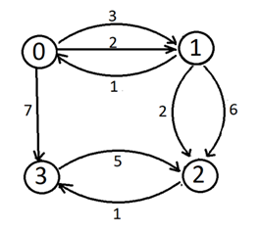
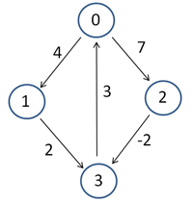
Sample Graphs
-
Sample1:
Contains multiple edges but all the edge costs are positive
Sample2:
Contains negative cost edges but no negative cost cycle
Sample3:
Contains negative cost cycle.

Slide 15
Thanks
Folder Link:
https://drive.google.com/drive/folders/1i9O-D5Paq2_ndkRF99Ebs9yGwLS_O08U?usp=sharing
Team:
Hare Krishna Agrawal - 19EC10028
Abhisht Bose - 19EC30002
Dikshant Pratap Singh - 19EC10078

